Slide 1
Introduction to R/RStudio

Slide 2
Outline
What is R and why do we use it?
Downloading R and RStudio
Basics of using R
Objects, assigning, and functions
Summary

Slide 3
Outline
What is R and why do we use it?
Downloading R and RStudio
- EX: download and start using
Basics of using R
- EX: Trying out commands
Objects, assigning, and functions
- EX: Using objects and functions in R
Summary

Slide 4
What is R and why do we use it?

Slide 5
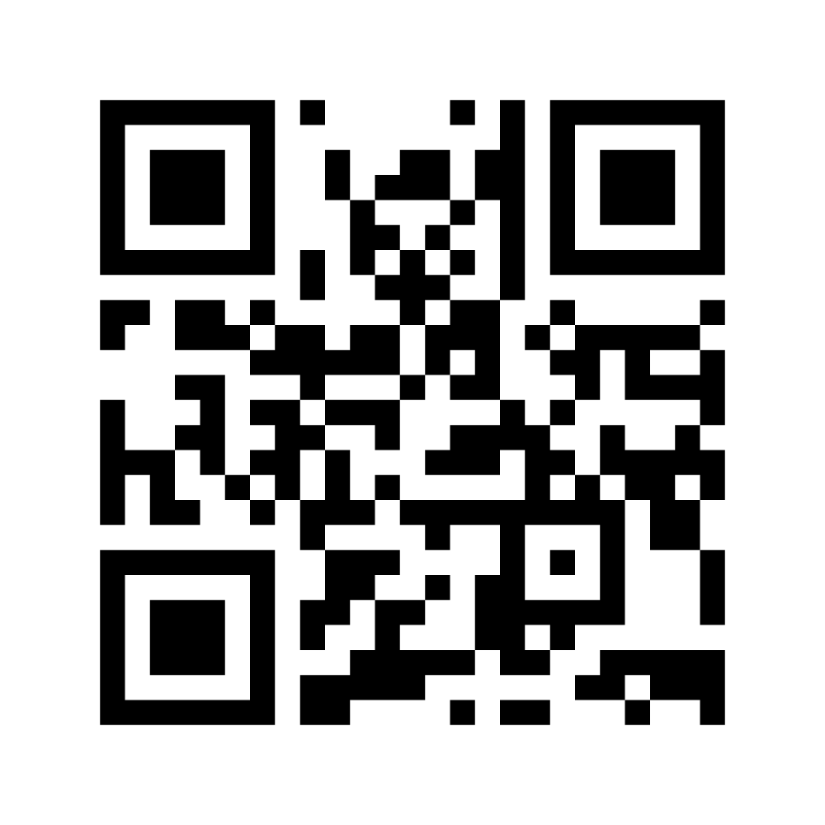
What is R and why do we use it?
Who has heard of
R before?
https://www.menti.com/28mosciyxe

Slide 6
What is R and why do we use it?
Open-source (FREE)
Statistical programming language
Widely used (popular) and cross platform
Flexible
Interpreted language (no need to compile)

Slide 7
What is R and why do we use it?
Open-source (FREE)
Statistical programming language
Widely used (popular) and cross platform
Flexible
Interpreted language (no need to compile)
Object orientated

Slide 8
What is R and why do we use it?
Language – so we have some new words:
Script
Comment
Assign
Function
Argument
Object
Notes:
Will do my best to explain and show you with the exercises, but also have definitions in the Glossary on Blackboard
<number>

Slide 9
How to use R

Slide 10
How to use R

Slide 11
How to use R
RStudio is an integrated development environment
(makes R pretty and has everything in one place)
It runs R
Also free and cross platform

Slide 12
Downloading R and RStudio
Notes:
To begin we actually need to put the programmes on our computers.
<number>

Slide 13
Exercise 1: Downloading R and Rstudio and getting started
Go to:
https://www.math.ntnu.no/emner/ST2304/2021v/Week01/R-tutorial.html
Open the file.
Work through Part A.
Ask if you need help! That’s what we are here for ☺

Slide 14
Recap

Slide 15
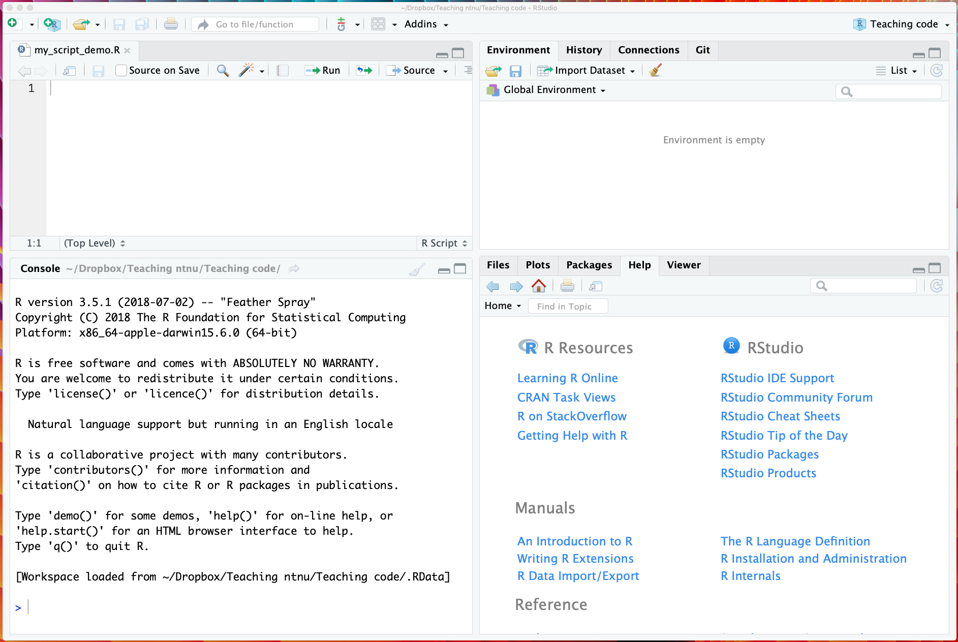
Using RStudio

Slide 16
Using RStudio

Slide 17
Using RStudio
Script window
Environment
Files/plots/packages/help/viewer
Console

Slide 18
Using RStudio
Console
Notes:
<number>

Slide 19
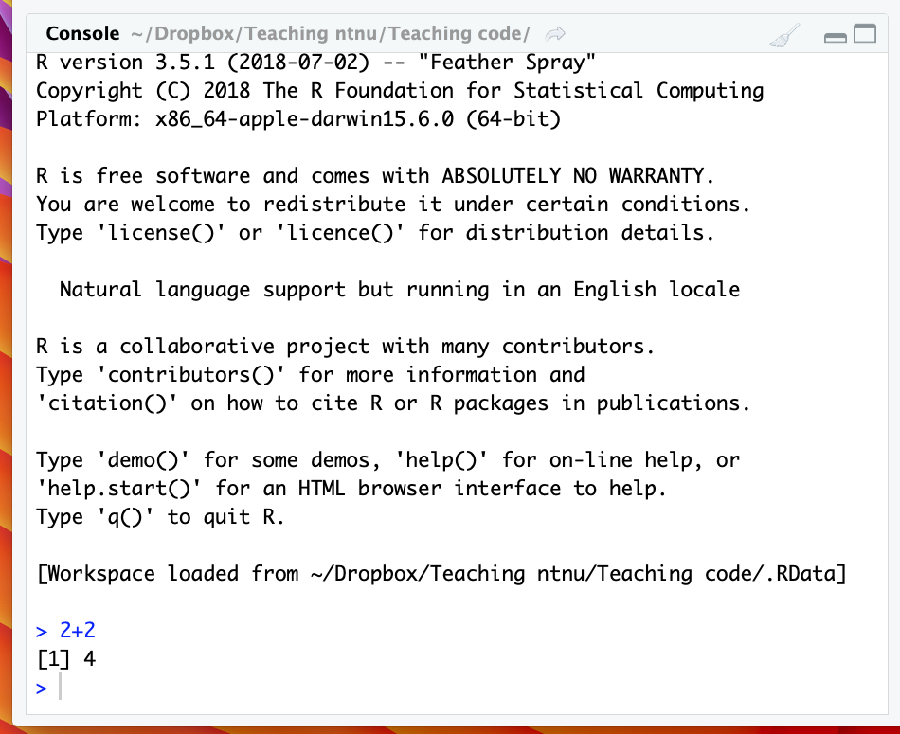
Using RStudio
Notes:
Hopefully you all managed to open the script and type in some code
<number>

Slide 20
Using RStudio
Notes:
It prints the answer, but then your code here disappears when you quit. This is a record, not something interactive.
<number>

Slide 21
Using scripts in RStudio
Script window
Notes:
Hopefully you all managed to open the script and type in some code
<number>

Slide 22
Why use scripts?
You can save your code
Easier to change the code
Easier to repeat analyses
You can use comments
Notes:
You closed Rstudio and reopened, everything you typed into the console is gone, but you still have it in your script.
<number>

Slide 23
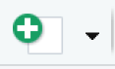
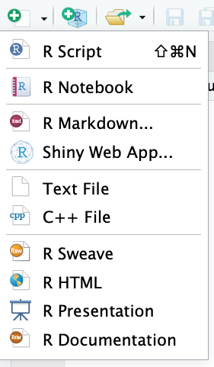
Basics of an R script
To open a new script

Slide 24
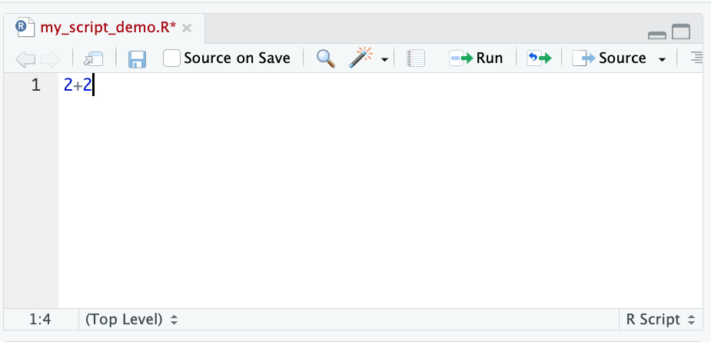
Basics of an R script

Slide 25
Basics of an R script
cmd + enter (Mac)
ctrl + enter (Windows)

Slide 26
Basics of an R script
cmd + enter (Mac)
ctrl + enter (Windows)

Slide 27
Comments

Slide 28
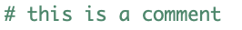
Comments
Notes:
Hash symbol
<number>

Slide 29
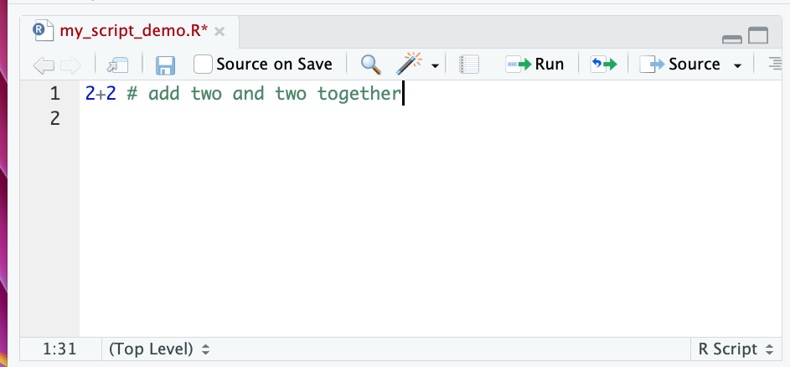
Comments
Notes:
Use comments to explain what the code does. Useful for yourself and for sharing.
<number>

Slide 30
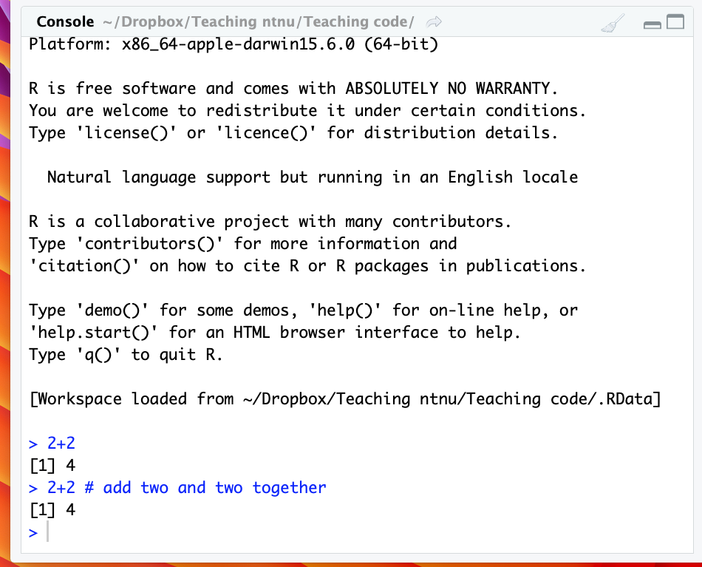
Comments
Notes:
Comments are not run, this line still gives the same result as before
<number>

Slide 31
Exercise 2: Trying out commands
Work through Part B
We are still here to help! ☺
There are several new words/concepts here but I will explain them afterwards

Slide 32
Key words from exercise 2
Notes:
<number>

Slide 33
Key words from exercise 2
Object
Assign
Functions

Slide 34
Key words from exercise 2
Object
Assign
Functions +
Arguments

Slide 35
Objects
Objects are created when you use assign and also created as the output of functions
R is object-orientated, so all about objects
Notes:
<number>

Slide 36
Objects
Less formal definition:
A virtual thing
Formal definition:
Everything in R is an object. Something stored in the memory of the programme with attached value or attributes
Notes:
<number>

Slide 37
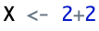
Objects
Notes:
<number>

Slide 38
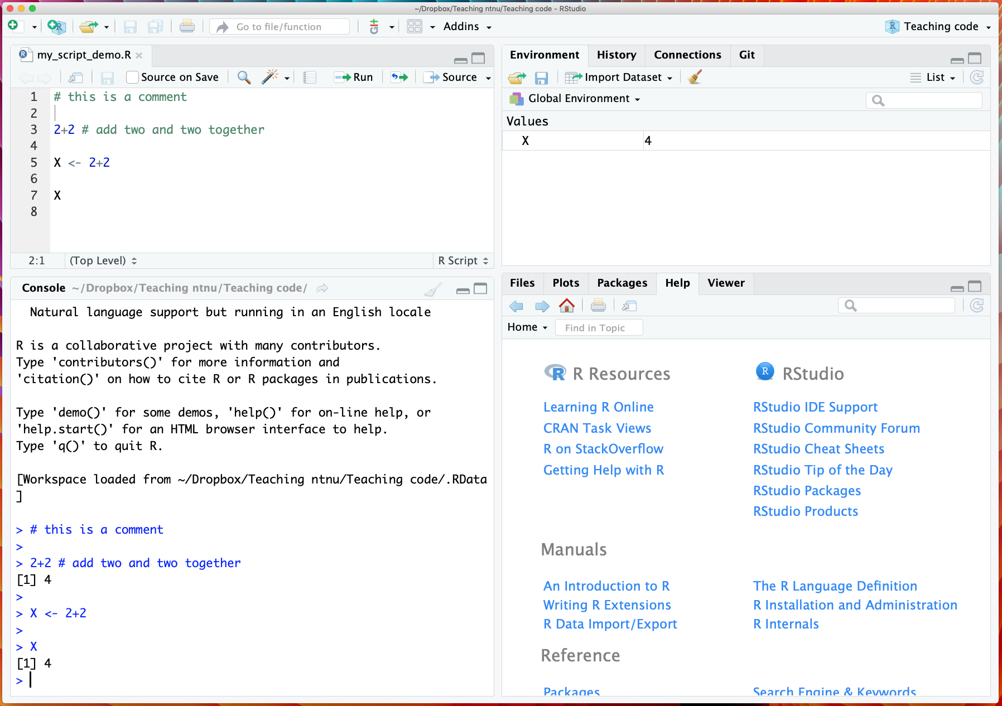
Objects
Now stored in R.
Notes:
<number>

Slide 39
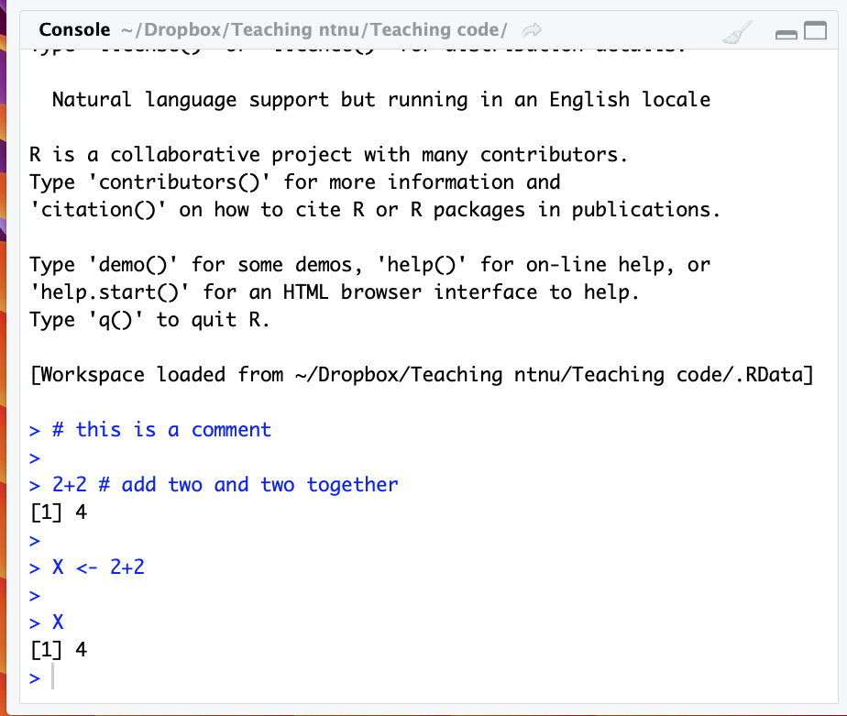
Objects
Now stored in R.
Notes:
<number>

Slide 40
Rules for objects
Cannot begin with a number e.g. 1object
Case sensitive e.g. case Case
Cannot be a fundamental function e.g. mean
Notes:
<number>

Slide 41
Assign/assigning
Notes:
<number>

Slide 42
Assign/assigning
Stores values as a name in R
Creates objects
Use = or <-
Notes:
<number>

Slide 43
Assign
Notes:
<number>

Slide 44
Functions
Stored code that takes an input and gives an output
Notes:
<number>

Slide 45
Functions
Stores code that takes an input and gives an output
Very useful for repeated processes
Can make our own or use others
Always outputs objects
Use arguments
Notes:
<number>

Slide 46
Functions
Examples of functions:
sqrt() # takes square root
log() # takes log
exp() # takes exponent
c() # combines values into something called a vector
seq() # creates a sequence of numbers
mean() # takes mean
Notes:
Wouldn’t want to always type the formula from scratch
<number>

Slide 47
Arguments
The input to a function
They are given to the function, which does something with them
Notes:
<number>

Slide 48
Arguments
The input to a function
They are given to the function, which does something with them
E.g.
sqrt(x) # takes square root of x
Notes:
<number>

Slide 49
Arguments
The input to a function
They are given to the function, which does something with them
E.g.
sqrt(x) # takes square root of x
Notes:
<number>

Slide 50
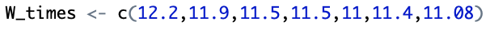
Examples
Notes:
<number>

Slide 51
Examples
Function
Notes:
<number>

Slide 52
Examples
Arguments
Function
Notes:
<number>

Slide 53
Examples
Assign
Arguments
Function
Notes:
<number>

Slide 54
Examples
Assign
Arguments
Object
Function
Notes:
<number>

Slide 55
Summary
What is R and why do we use it?
Downloading R and RStudio
Basics of using R
Objects, assigning, and functions

Slide 56
Summary
What is R and why do we use it?
Open source statistical programming language
Free and flexible!
Downloading R and RStudio
Should be done
Basics of using R
Looked at scripts, comments, console, running
Objects, assigning, and functions
Looked at how to assign objects and how to use functions

Slide 57
How to learn more about R
Notes:
Will let you carry on with the last two exercises if you want today. Also recap tomorrow. But here are some tips to become and R wizard
<number>

Slide 58
How to learn more about R
Search for and ask for help!
Google is great resource
Help files in RStudio
CRAN (where you download R)
Ask us

Slide 59
How to learn more about R
Search for and ask for help!
Google is great resource
Help files in RStudio
CRAN (where you download R)
Ask us
None of us have memorised it all!

Slide 60
How to learn more about R
https://digit.ntnu.no/courses/course-v1:NTNU+IMF001+2020/course/
Nice R course that can follow on from the tutorial for this course
Notes:
Will let you carry on with the last two exercises if you want today. Also recap tomorrow. But here are some tips to become and R wizard
<number>

